Slide 1
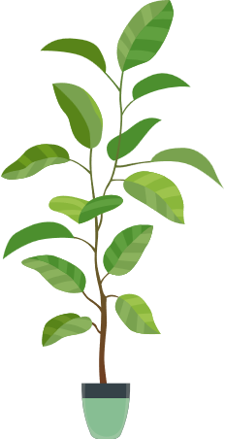
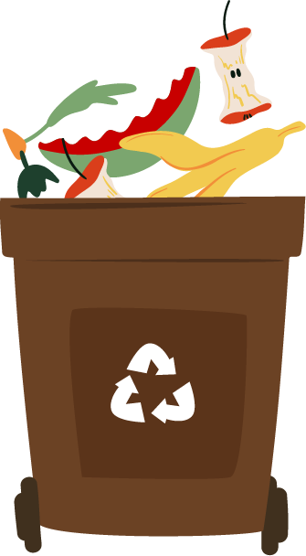
Introduction
Notes:
Hi everyone, I am _______ and I’m here on behalf of enuf, we have partnered with the CSU and GSA to promote waste reduction initiatives, with a concrete focus on what we can do here at school. A large portion of what institutions send to the landfill can be diverted to compost centers with a more collaborative effort to reduce bin contamination. On that subject, I would like to start with a video

Slide 2
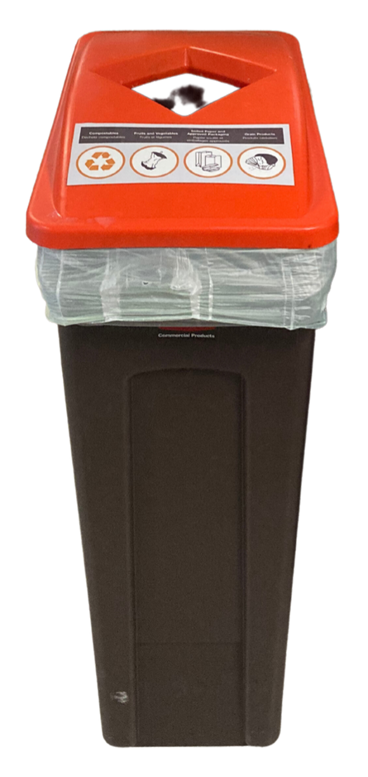
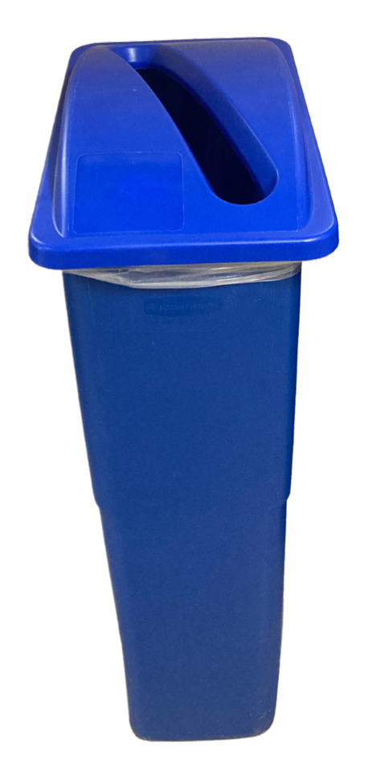
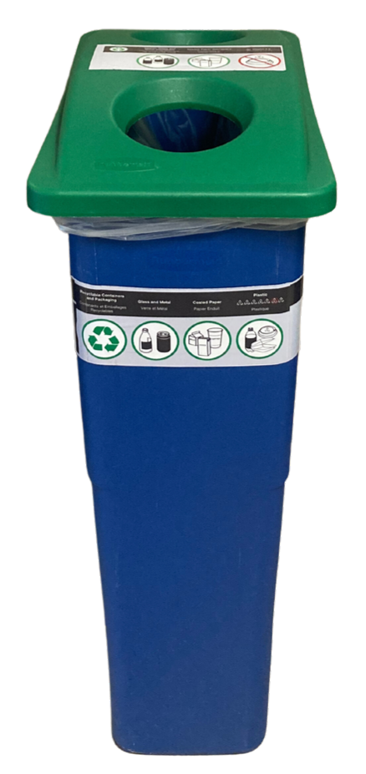
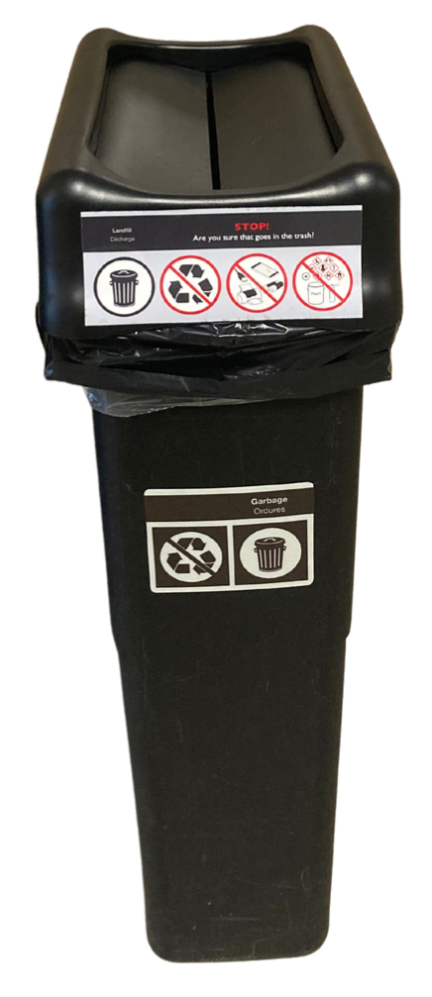
Cheat Sheet
COMPOST
SPECIFIC RECYCLING
MIXED RECYCLING
GARBAGE
Any food waste
Soiled paper (e.g. plates, napkins)
Soiled cardboard (e.g. pizza boxes))
Clean paper
Clean cardboard
(Rinsed) plastics #1-5
Metal
Glass
Metal
Plastic #6 (e.g. coffee cup lids)
Styrofoam
Everything else
Notes:
So here’s a quick review: The orange lidded bins are our compost bins, and that’s where you put all food waste, including bones, shells and rotten food, soiled paper like Kleenex and brown paper towels, and soiled cardboard like greasy pizza boxes.
The blue-lidded bin is specifically for clean paper and clean cardboard, which includes all printed materials, while the green-lidded bin is for mixed recycling, including clean metal, clean glass, and clean plastics #1-5. Finally, everything else will go into the garbage bin, which includes plastic #6, Styrofoam, wrappers, and almost all packaging. This is also where you would put dirty recyclable materials if you cannot clean them.

Slide 3
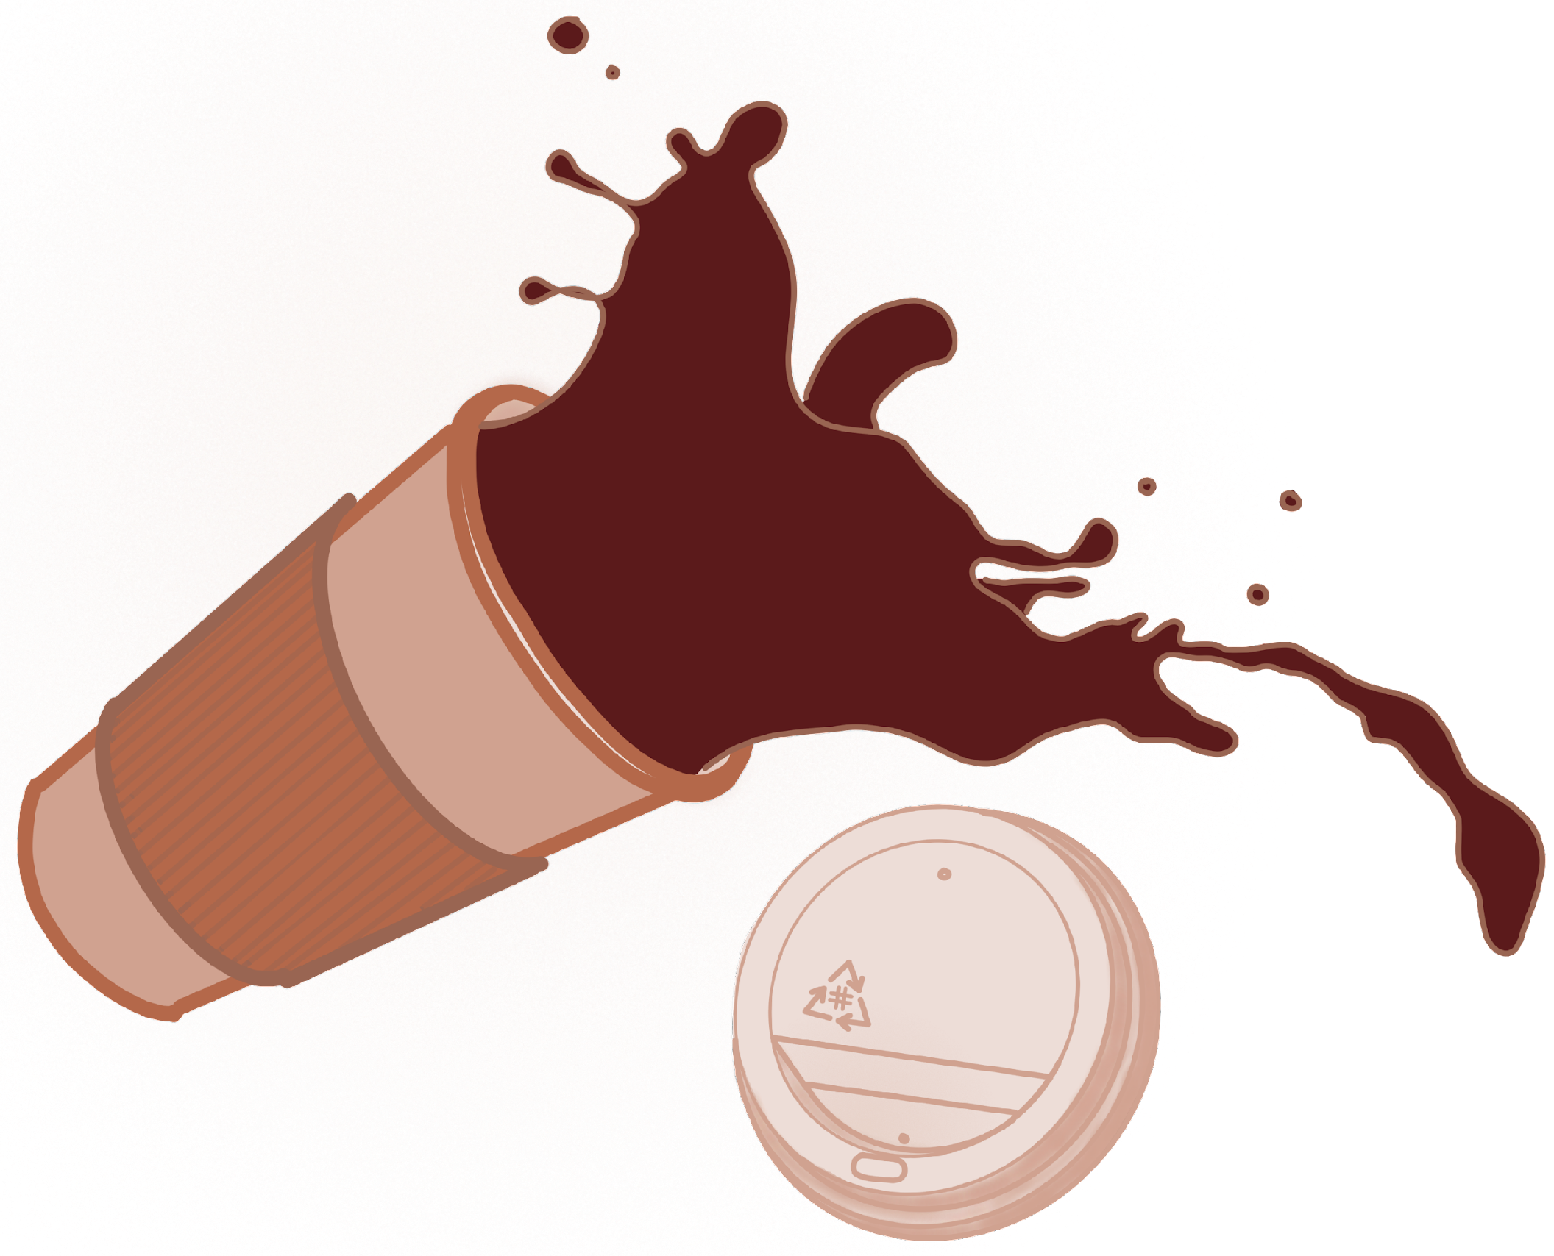
Waste Sorting at Concordia Vs. Home
CUP
At Concordia – rinse & recycle
At home – landfill
No liquids in bins
LID
Plastic #5 – recycle
Plastic #6 – landfill
SLEEVE
Recycle or compost
Notes:
At Concordia one of the biggest sources of waste we see are coffee cups. There are multiple parts that need to be separated, and the first thing to do is to ensure that the cup is empty. For the safety and security of our custodial staff, look for a water fountain or a sink, or if you’re outside empty the liquids onto the ground, but don’t put liquids in any of the bins. The cup has a plastic lining thatcan make it hard to recycle. At Concordia, the coffee cups can go into the mixed recycling green bin with plastics, but at home it is more likely that it will need to go into the garbage. The paper sleeve can be recycled in the blue bin if clean and composed if soiled.
And the plastic lid should go in the green recycling bin if it’s #5 and in the garbage bin if it’s #6.

Slide 4
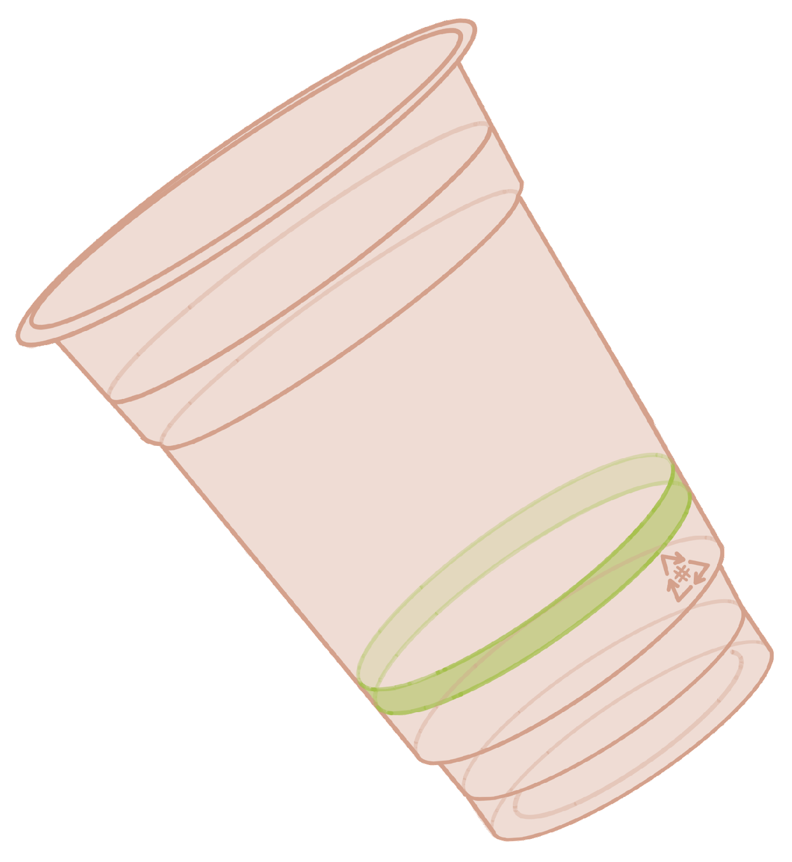
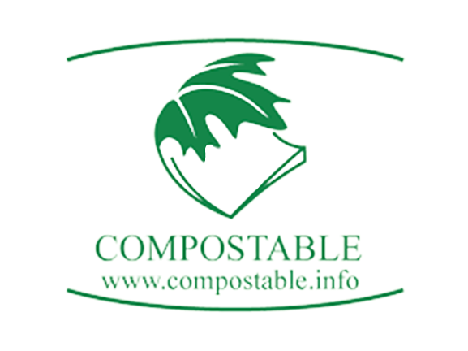
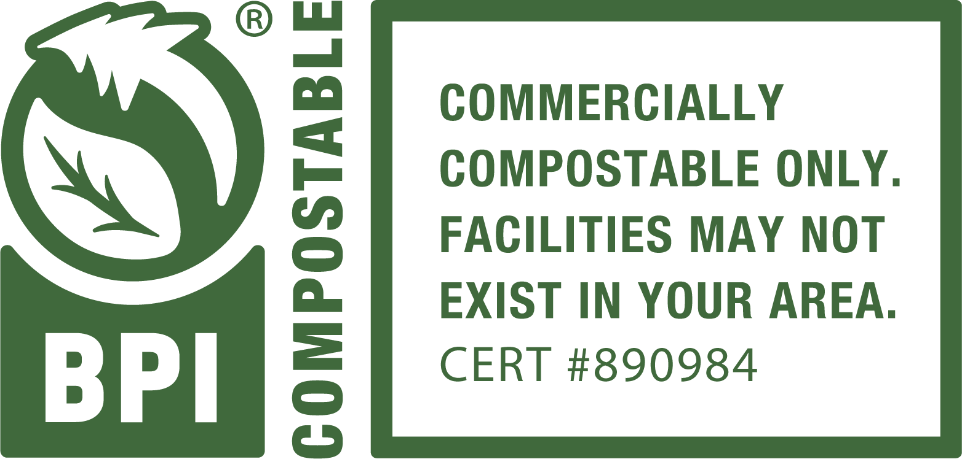
Waste Sorting at Concordia Vs. Home
Plastic #7 – certified compostable
At Concordia – Compost
At home – Garbage
Compost certifications :
Biodegradable ≠ Compostable
Notes:
Another common thing to see on campus is compostable plastic. These are labelled #7, meaning « other » and including plant-based plastics, and will have a certification of compostability, in which case they can be put into the orange bins at school. Be careful however that biodegradable is not equivalent to compostable. At home, it is unlikely that they will be accepted in the municipal compost program, and so it will be better to put them in the garbage bin.

Slide 5
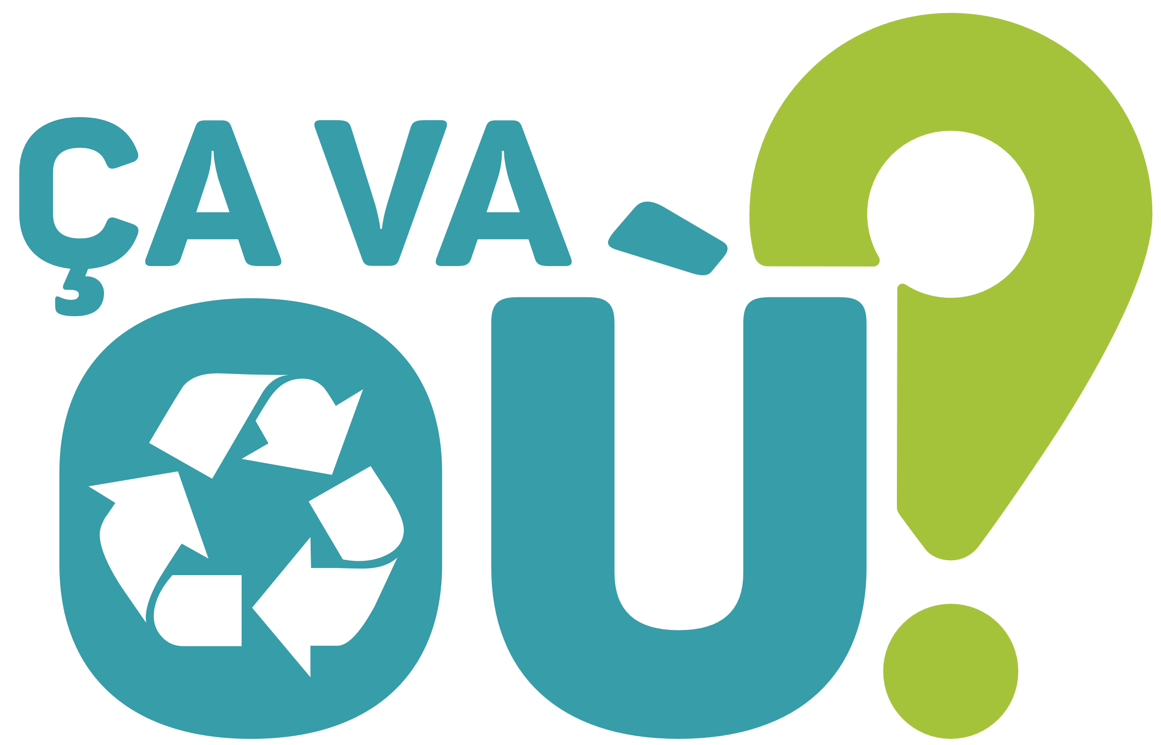
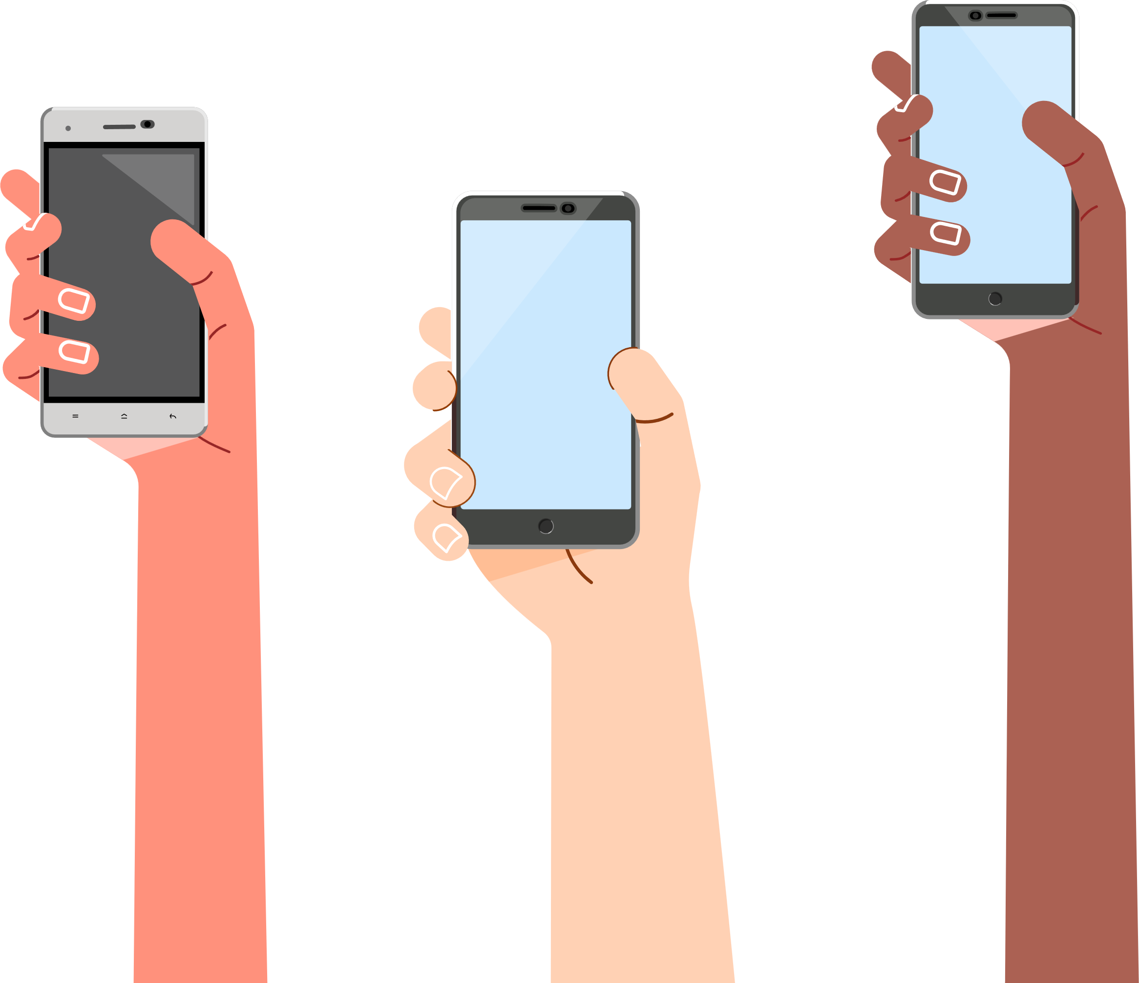
More Info
Search for local Éco-quartiers
& community composting sites
Web + mobile app by
Notes:
It can get a little confusing to know how to sort, especially because there is no unified standard across different municipalities, but thankfully there are many resources you can turn to. Recyc-Québec has developed a handy application called « Ça Va Où? », it is a bilingual, location-based search engine where you can look up specific materials and be guided on how to sort them according to the rules of your municipality. There are also local Éco-quartiers and community composting sites you can turn to for more information.

Slide 6
Questions?
@enufCanada
enufCanada.ca
Community@enufCanada.ca
Notes:
That's everything, if you have any questions right now, I would be happy to answer them, if not please feel free to reach out to us online. Thank you for your time!

